Slide 1
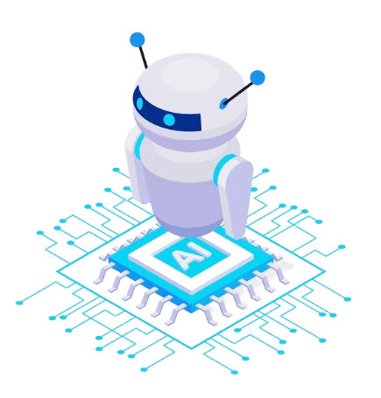
Quizify
AI based Quiz Generator
Noor-Ul-Ain Ejaz
Zainab Zulfiqar

Slide 2

AGENDA
Introduction to Quizify
Features of Quizify
Used Technology
Use Cases
Future Enhancement

Slide 3

Introduction
Quizify is an innovative quiz generation platform designed to provide users with a fast, efficient, and cost-effective way to create and access quizzes.
Whether for education, training, or entertainment, Quizify makes quiz creation simple and hassle-free.

Slide 4

FEATURES
Cost-Effective
Fast Quiz Retrieval
Customizable Quizzes
Scalability
User-Friendly Interface

Slide 5



Technology
Streamlit for Frontend
Python for backend
Pickles files for Database
LLM and pydantic Basemodel

Slide 6

USE CASES
Employee Training and Certification
Onboarding Quizzes
Compliance and Legal Training
Client Education:
Educational Quizzes for Clients
Interactive Learning

Slide 7
USE CASES
Internal Knowledge Assessments:
Skill Assessments
Continuous Learning
Customer Support Training
Product Knowledge
Troubleshooting Techniques

Slide 8

Future Enhancement
Mobile App to reach more users on-the-go.​
Video Generated Quizzes Management​
Multilingual Support​

Slide 9
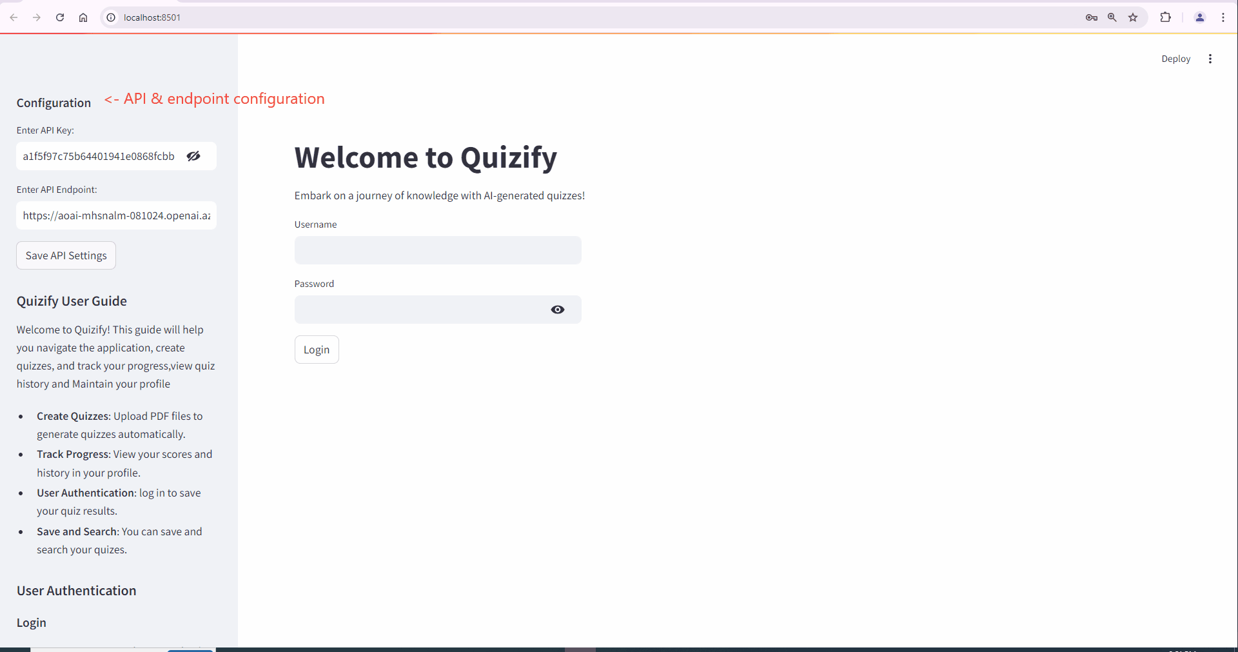
DEMO

Slide 10
THANK YOU

